Slide 1
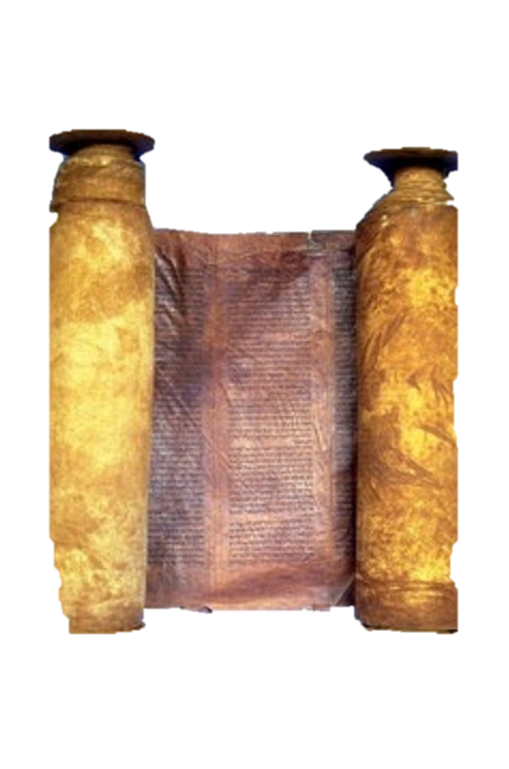
A free CD of this message will be available immediately following the service
1 Kings
3-5
A podcast will also be available later this week at calvaryokc.com

Slide 2
Ps. 37.4 ~ Delight yourself also in the Lord, and He shall give you the desires of your heart.
1 Jn. 5.14 ~ Now this is the confidence that we have in Him, that if we ask anything according to His will, He hears us.
1 kings 3-5

Slide 3
Matt. 6:33 ~ But seek first the kingdom of God and His righteousness, and all these things shall be added to you.
1 kings 3-5

Slide 4
1 kings 3-5

Slide 5
Understanding ~ shamah – literally, to hear attentively
Deut. 6:4 ~ Hear, O Israel: The Lord our God, the Lord is one!
1 kings 3-5

Slide 6
1 kings 3-5

Slide 7
Israel under Solomon
Modern boundaries
1 kings 3-5

Slide 8
1 kings 3-5

Slide 9
15,000 - 36,000 people
1 kings 3-5

Slide 10
1 kings 3-5

Slide 11
40,000 ~ 2 Chron. 9:25, 4,000
Deut. 17:16 ~ But he shall not multiply horses for himself, nor cause the people to return to Egypt to multiply horses, for the Lord has said to you, "You shall not return that way again."
1 kings 3-5

Slide 12
1 kings 3-5

Slide 13
Largeness of heart ~ i.e., pursuit of knowledge or ability to learn
1 kings 3-5

Slide 14
1 kings 3-5

Slide 15
Jewish tradition:
Ethan ~ Abraham
Heman ~ Moses
Chalcol ~ Joseph
Darda ~ Children of Israel in the Wilderness
1 kings 3-5

Slide 16
1 kings 3-5

